Slide 1
Data Science: Big Data Management Systems & Tools
Module 2: Relational Databases and Data Warehouses

Slide 2
Module 2 Learning Outcomes
Describe the Relational Model and how it functions
Explain the similarities and differences between Databases vs Data Warehouses
Extend your knowledge of the Structured Query Language (SQL)
Demonstrate some Advanced SQL features
Notes:
The focus of this module around a traditional data model (legacy technology data stacks)
There are drawbacks in this setup, with the type of data and data volume

Slide 3
The Relational Model
The Relational Model was proposed by Edgar Codd back in 1970 while working at IBM
The relational model is used to store structured data
Popular relational databases include:
ORACLE
DB2
Microsoft SQL Server
MySQL
PostgreSQL
Notes:
Structured: tabular format, rows and column, think spreadsheets
Example: students in a school and their graders
Unstructured: images, videos, voice recording

Slide 4
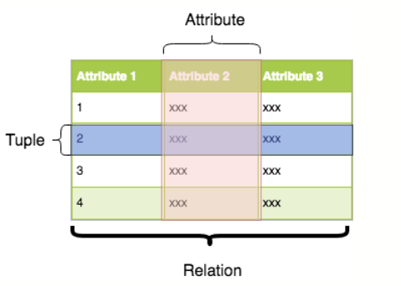
The Relational Model
Relational theory has several key concepts:
Attribute: A characteristic of interest for all members of a relation
Tuple: The attributes of a member of a relation
Relation: A set of tuples
All tuples in a relationship have the same type
You can interact with such a model using a structured query language (SQL)
Notes:
Relation = table
Attribute = column
Tuple = row

Slide 5
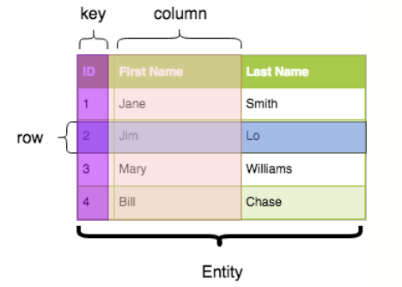
Entities and Relationships
Real world data is described by these concepts:
Entity: A person, place or thing
Key: An attribute on an entity that uniquely identifies one entity, distinguishing it from another
Relationship: an association between entities
Constraint: a set of rules on Entities, Keys or Relationships

Slide 6
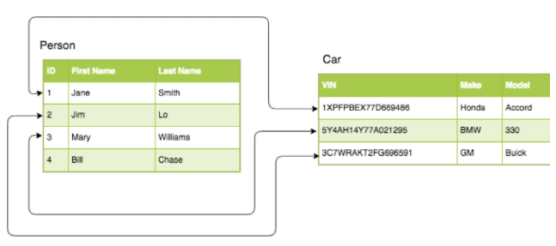
Relationships

Slide 7
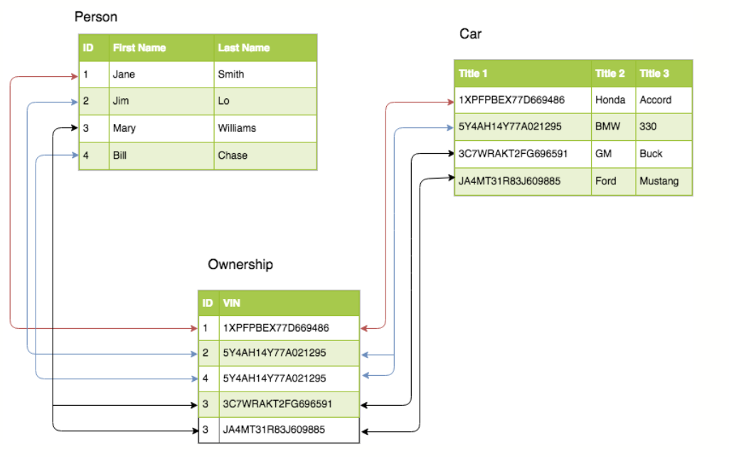
Normalization
Notes:
Normalized data is organized into multiple related tables, each with a specific purpose, for the sake of minimizing data redundancy and dependency.
Imagine one really wide table, versus multiple narrow tables
Wide tables can be great in some cases, but querying them can get expensive

Slide 8
Entity-Relationship Diagrams
Pet
Owner
is owned by
owns
Notes:
One to one, one to many, many to many
Better picture: https://i.sstatic.net/9tvIZ.gif

Slide 9
Subtypes
Pet
Cat
Dog
Notes:
Further breakdown of general types

Slide 10
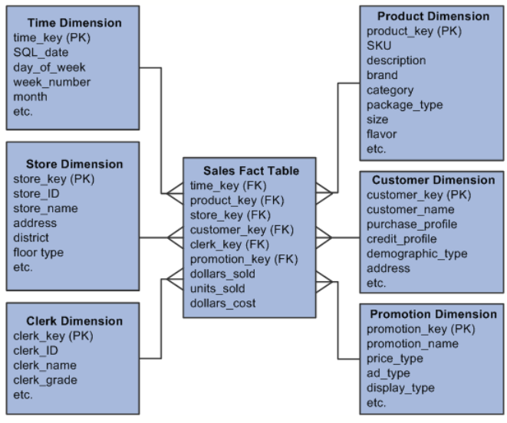
Star Schemas
Notes:
Type of database schema, with a fact table in the center with dimensions all around.
Fact table is where you store your transactions (order, shipments) and dimension is very you store details about that transaction.
This setup is used for its ease and simplicity and quick performance

Slide 11
ACID transactions support data consistency
A transaction is a unit of work that can be made up of one or more operations
Transactions improve data consistency and availability by
Atomicity: each transaction is guaranteed to completely succeed or completely fail
Consistency: a transaction can only bring the database from one valid state to another
Isolation: ensures that concurrent execution of transactions leaves the database in the same state as if executed sequentially
Durability: committed transaction remains committed even in the case of a system failure
Notes:
Powerful properties, that make relations db super useful!
ACID is setup for default but a DBA would setup of the configuration on the levels of ACID that are followed.
Atomicity: This property ensures that either all operations within a transaction are completed successfully, or none of them are. If any part of the transaction fails, the entire transaction is rolled back to its original state. Example: Consider a bank transfer transaction where money is withdrawn from one account and deposited into another. If the withdrawal is successful but the deposit fails due to a network issue, atomicity ensures that the withdrawal is rolled back, and the original state of both accounts is restored.
Consistency: This property ensures that the database remains in a valid state before and after the execution of a transaction. It guarantees that all data integrity constraints are maintained. Example: In a database where the total balance of all accounts must remain constant, a transaction that transfers funds between accounts should ensure that the total balance is preserved before and after the transaction.
Isolation: Isolation ensures that the intermediate state of a transaction is invisible to other transactions until it is committed. This prevents interference between concurrent transactions. Example: Suppose two users simultaneously attempt to update the same bank account balance. Isolation ensures that one user's transaction does not see the changes made by the other user's transaction until it is committed, preventing inconsistencies.
Durability: Durability guarantees that once a transaction is committed, its effects persist even in the event of a system failure. The changes made by a committed transaction are permanent and will not be lost. Example: After a successful bank transfer transaction, where funds are withdrawn from one account and deposited into another, the changes to account balances are permanently stored in the database and will not be lost, even if the database system crashes.

Slide 12
Types of Relational Datastores
Operational Datastores (ODS)
A type of database that receives information from different data sources
It serves as short-term storage that contains the most up-to-date snapshots of business operational data
Organizations use ODSs to perform simple queries, usually on relatively small datasets
Used to handle daily operational and reporting needs
Data Warehouses (DW)
Provide longer term storage and contains historical data
A means to run complex, long running queries
Removes processing load of complex queries from ODSs

Slide 13
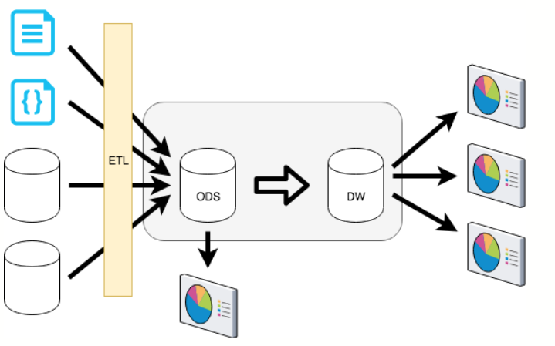
Interaction Between the ODS and DW
Notes:
ETL - extracting, transform and loading

Slide 14
Cloud-based Relational DBMS’s
Many of the public cloud providers have native relational database management services. For example:
Amazon AWS
Amazon RDS: A collection of managed services compatible with many on premises relational databases like Oracle, SQL Server and PostgreSQL
Amazon Aurora: Cloud-based relational DBMS compatible with MySQL and PostgreSQL
Microsoft Azure
Azure SQL database
Azure Database for PostgreSQL
Azure Database for MySQL
Azure SQL Managed Instance

Slide 15
Cloud-based RDBMS’s (cont’d)
Many of the public cloud providers have native relational database management services. For example:
Google
AlloyDB for PostgreSQL
Cloud SQL
Cloud BigTable
ORACLE
ORACLE Database Services

Slide 16
SQL
Any complete language for working with data must support four fundamental operations, often referred to collectively as CRUD:
Create: Add a new record (row) to the database
Read: Retrieve one or more records from the database, usually subject to some criteria
Update: Change the data in one or more existing database records to update them
Delete: Remove one or more records

Slide 17
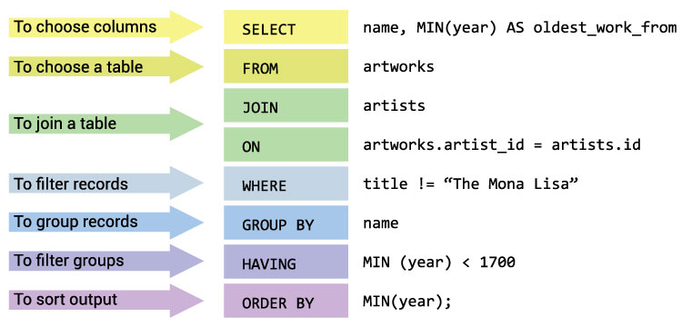
Advanced SQL
CASES (similar to if then else ),
Scalar Functions [LOWER()]
String Matching (LIKE = ‘%cola%’) ,
Smarter Filtering
[Year IN (2021,2022)]
[Year BETWEEN 1990 AND 2000

